Slide 1

Blockchain - Secure Communication and Sensitive Patient Data
Constance Babcock

Slide 2
Define and explain blockchain
Distributed
Peer to Peer
Decentralized
If one node is tampered, the data is not compromised
Direct peer to peer transaction of data or finance
Control is distributed among multiple participants

Slide 3
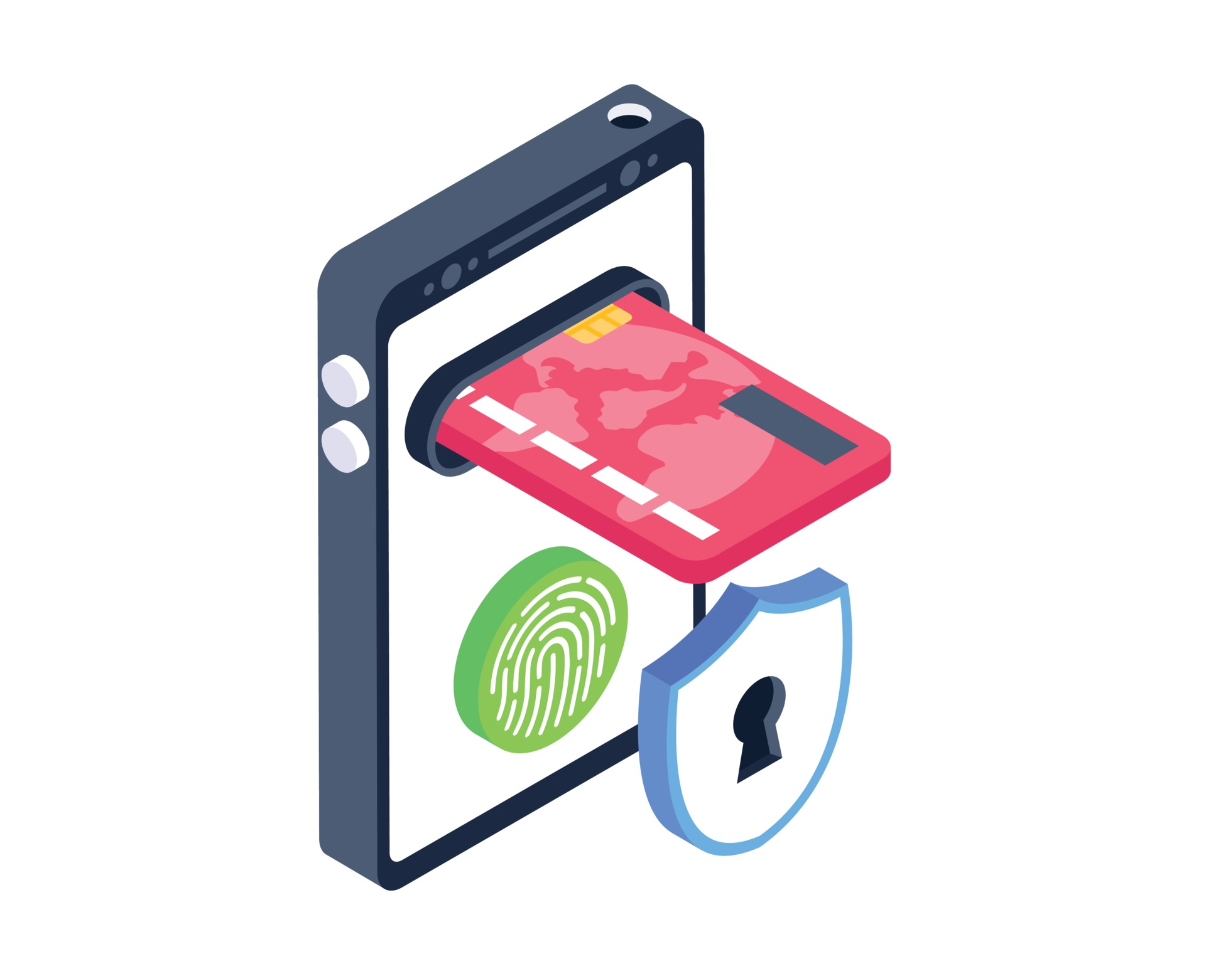
ways to use blockchain
Secure transactions
Blockchain is highly effective against tampering from other party's
That makes any data that is store to be the most up to date, trustworthy because it is distributed
Sensitive Data and Verification
Perfect for sensitive data including patent records, transactions, and keeping that data unapologetically up to data and secure
The decentralized nature instills trust between two unknown parties that can lead to secure interaction

Slide 4

In-depth of Blockchain healthcare software
Medicalchain
MyClinic.com - provides immediate retrieval of health records, allowing patients to communicate directly with doctors and share their health records for online consultations
SoluLab
Enterprise Blockchain Development - Unlock the future of secure and transparent business operations with our enterprise blockchain development expertise.
Smart Contracts Development - Our tailored smart contract solutions ensure seamless and secure transactions on the blockchain, helping elevate business efficiency

Slide 5
Timeline of blockchain
Described for the first time by Stuart Haber and W. Scott Stornetta
Computer scientist Nick Szabo works on decentralized digital currency
Stefan Konst publishes his theory of cryptographic secured chains, plus ideas for implementation
2014
2009
2000
Blockchain 2.0 is born, referring to applications beyond currency
Nakamoto implements the first blockchain as the public ledger for bitcoin
1998
1991

Slide 6
Works Cited
Albeyatti, A. (2022). Home. Medicalchain. https://medicalchain.com/en/
Ivan on Tech. “Building a Blockchain in Under 15 Minutes - Programmer Explains.” YouTube, YouTube, Aug. 2017, www.youtube.com/watch?v=baJYhYsHkLM&t=222s
Chronicled, Inc. “The Mediledger Network.” The MediLedger Network, 2024, www.mediledger.com/
SoluLab. “Blockchain Development Company.” Blockchain Technology, Mobility, AI and IoT Development Company USA, Canada, 12 Aug. 2024, www.solulab.com/blockchain-development-company/
ICAEW. “History of Blockchain.” ICAEW, 2024, www.icaew.com/technical/technology/blockchain-and-cryptoassets/blockchain-articles/what-is-blockchain/history
Law , Freeman. Blockchain Technology Explained | What Is Blockchain and How Does It Work?, freemanlaw.com. Accessed 18 Aug. 2024
Smashingstocks. Secure Transaction and Payment Pro Vector. Secure Transaction and Payment Pro 3030452 Vector Art at Vecteezy, https://www.vecteezy.com/vector-art/3030452-secure-transaction-and-payment

